Slide 1
Notes:
You are welcome to use or modify these PowerPoints as needed. Feel free to change the design or layout to suit your ministry, school, home, or company. More PowerPoint slides can be found at mobilehymns.org

Slide 2
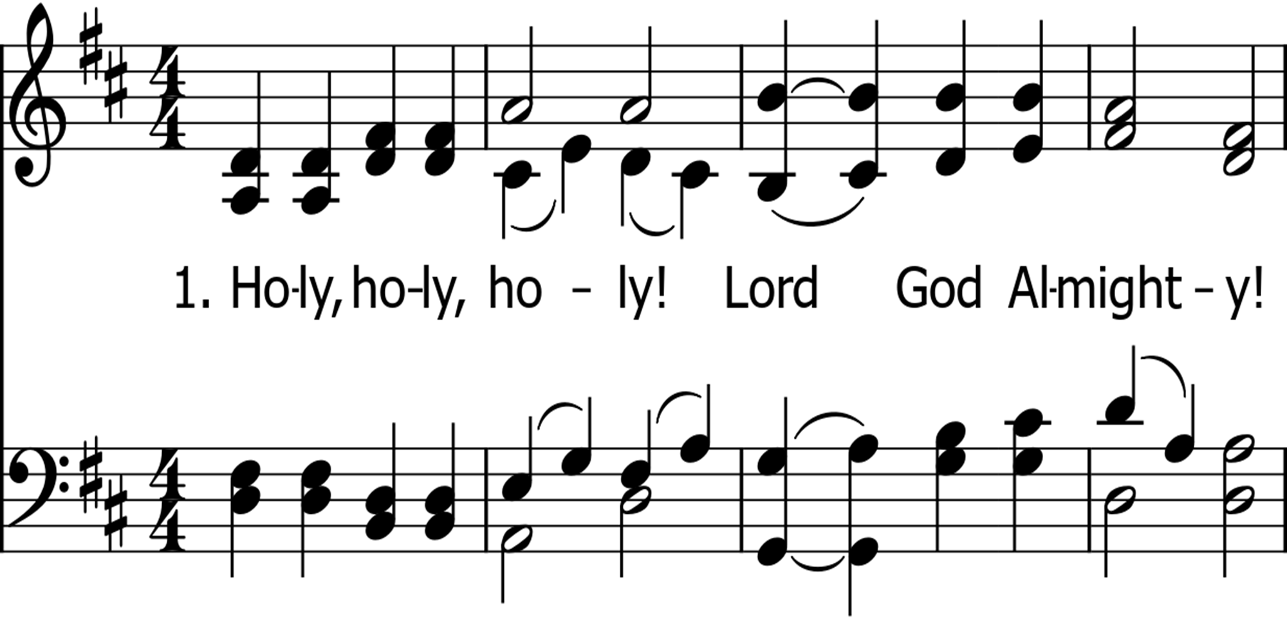

Slide 3
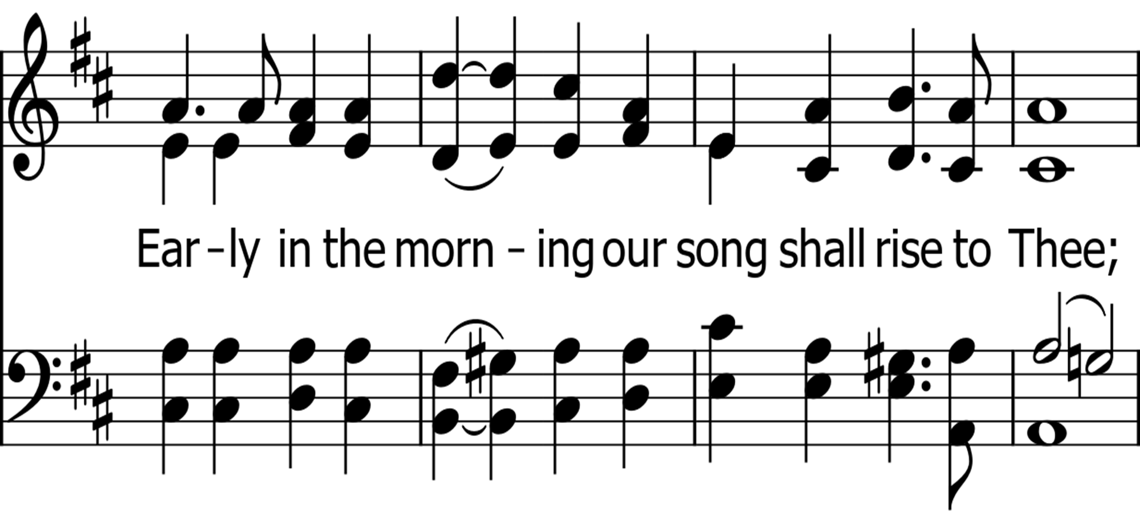

Slide 7
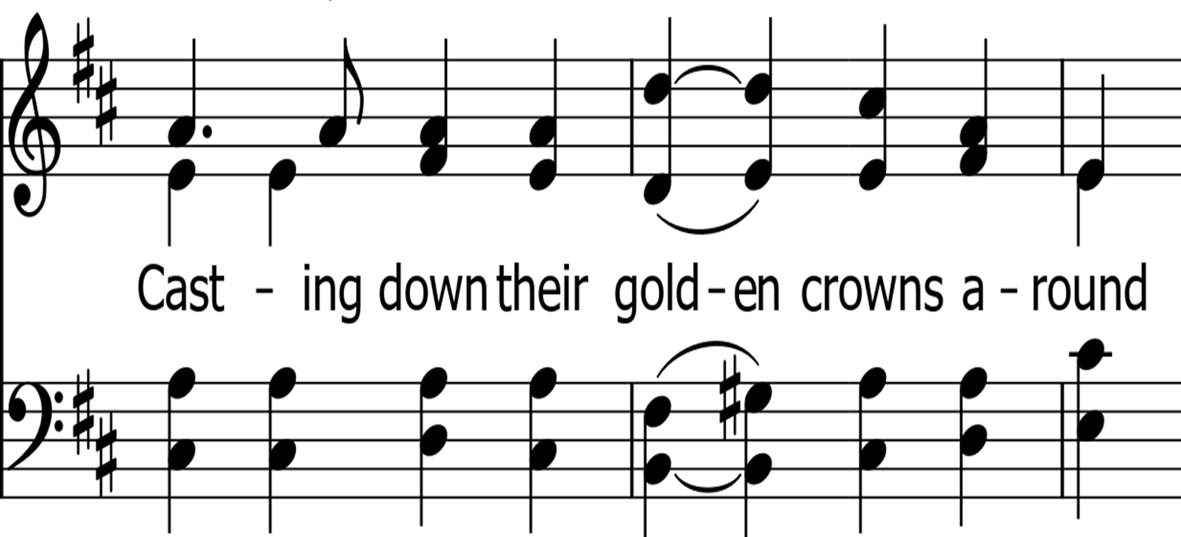

Slide 11
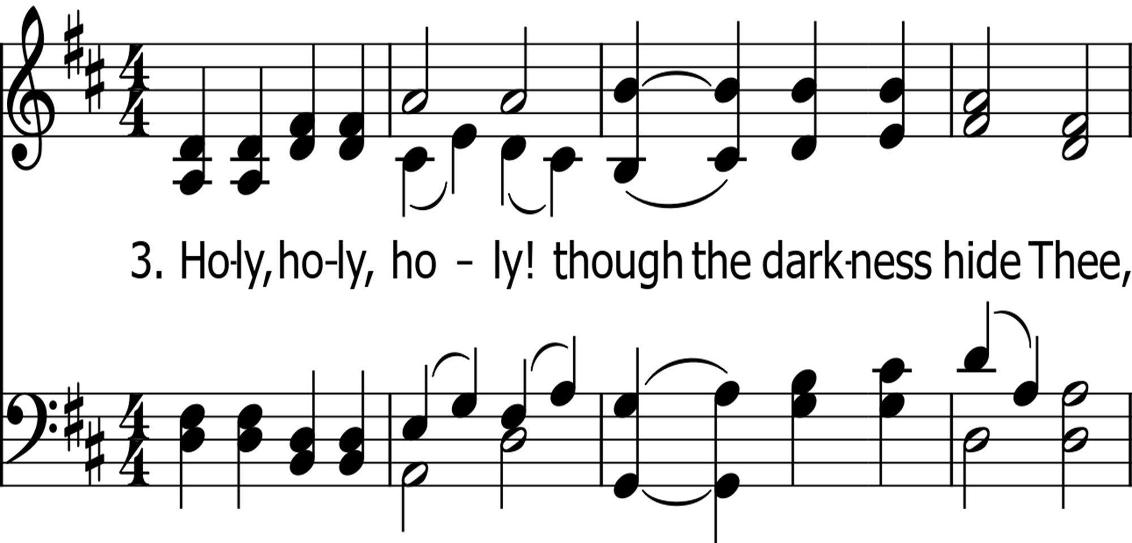

Slide 13
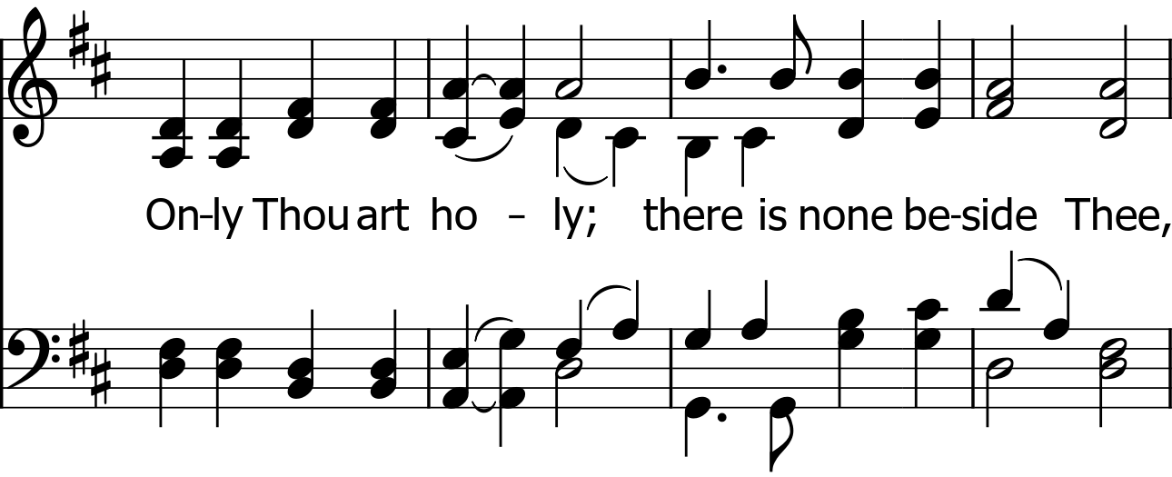

Slide 15
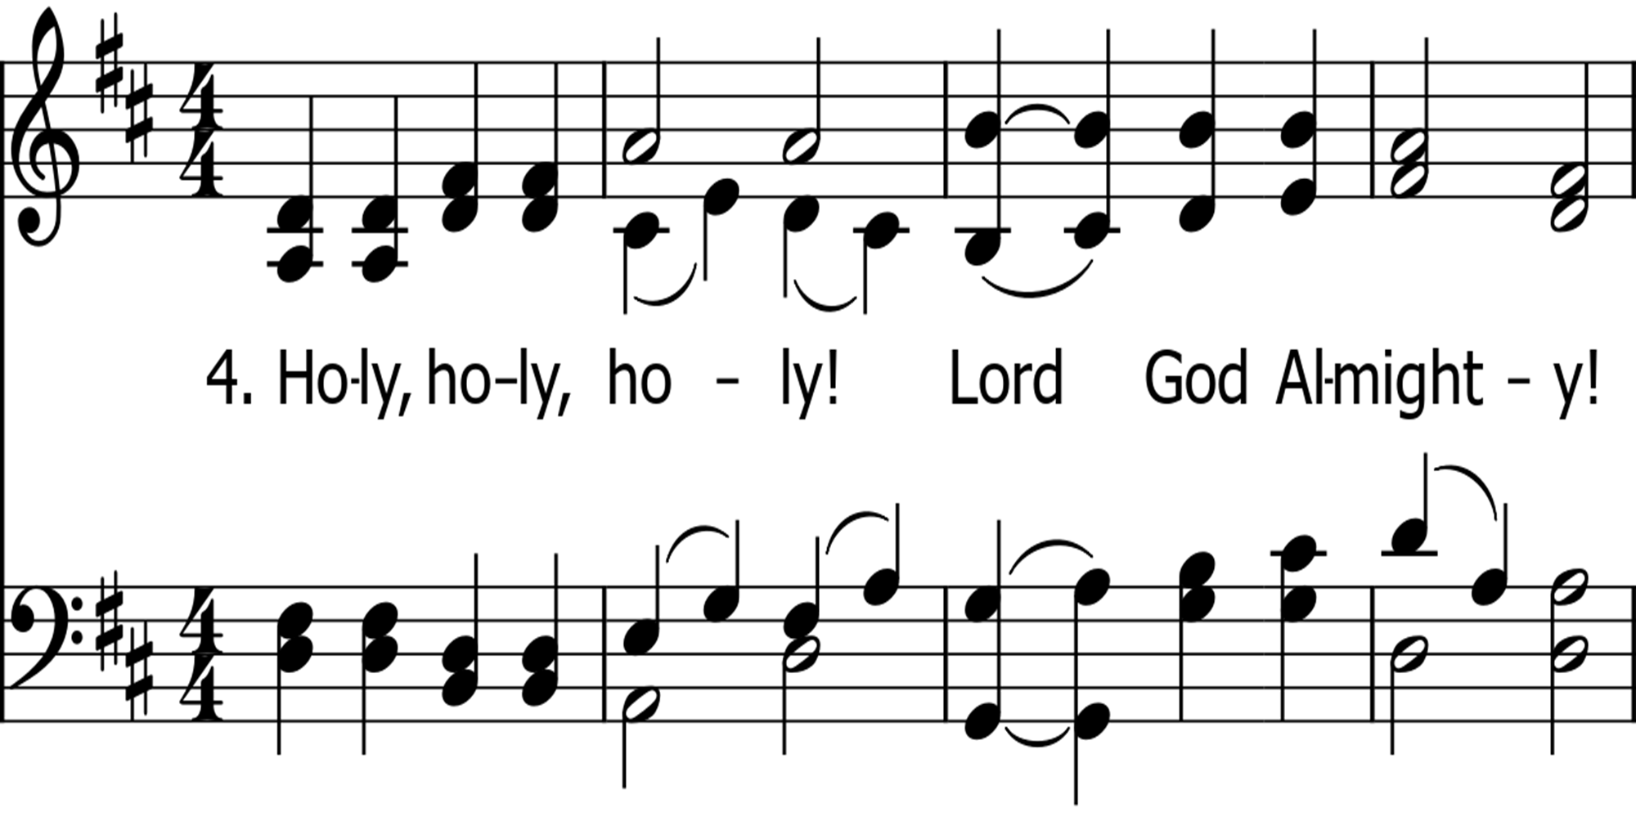

Slide 19
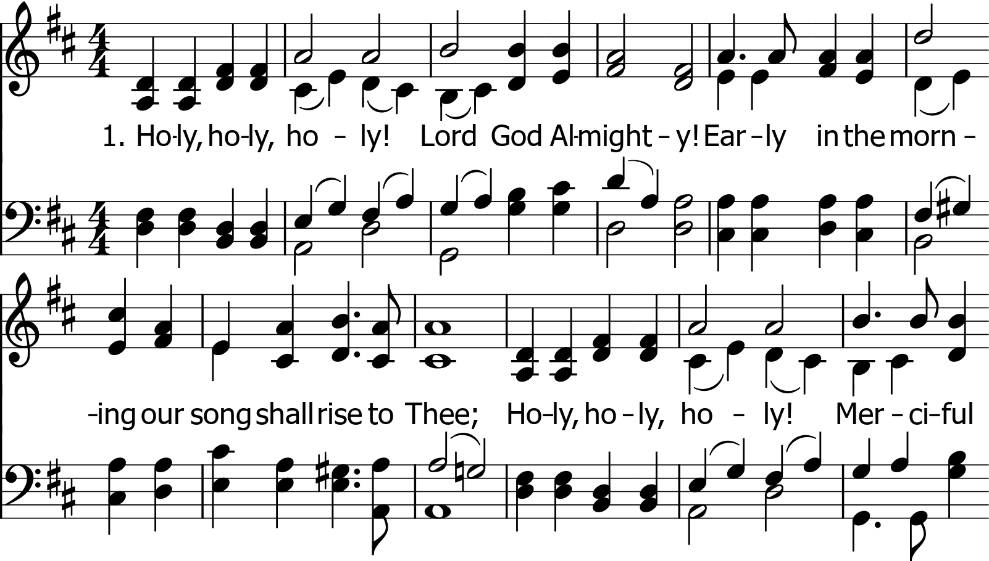

Slide 20
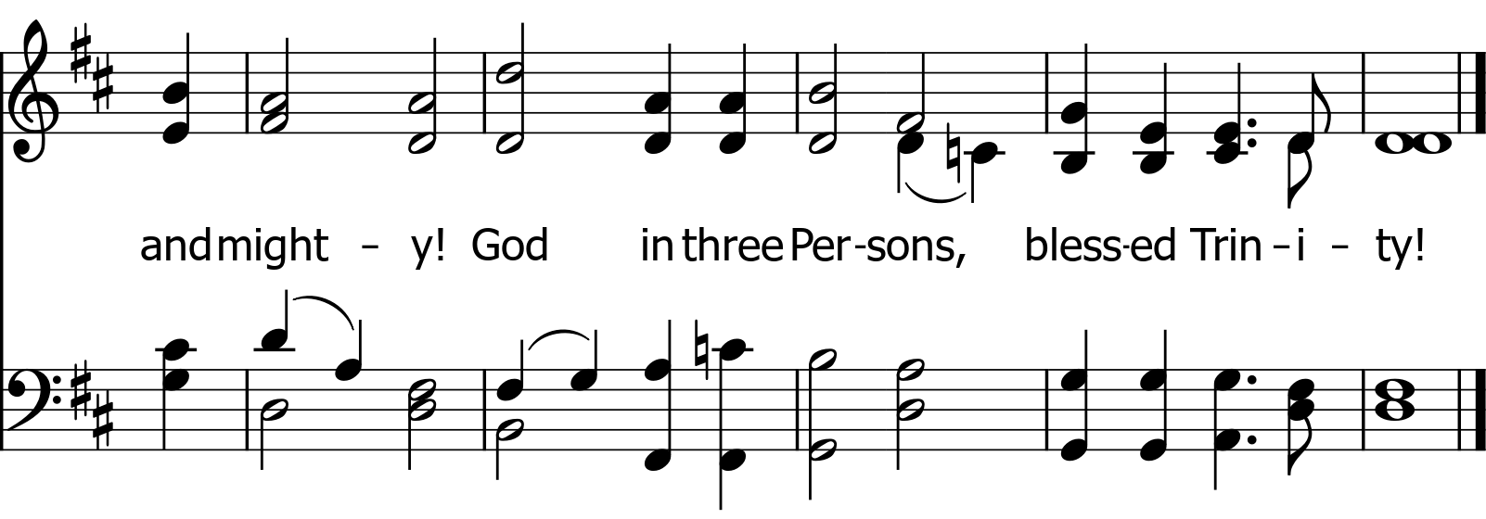
Public Domain

Slide 21
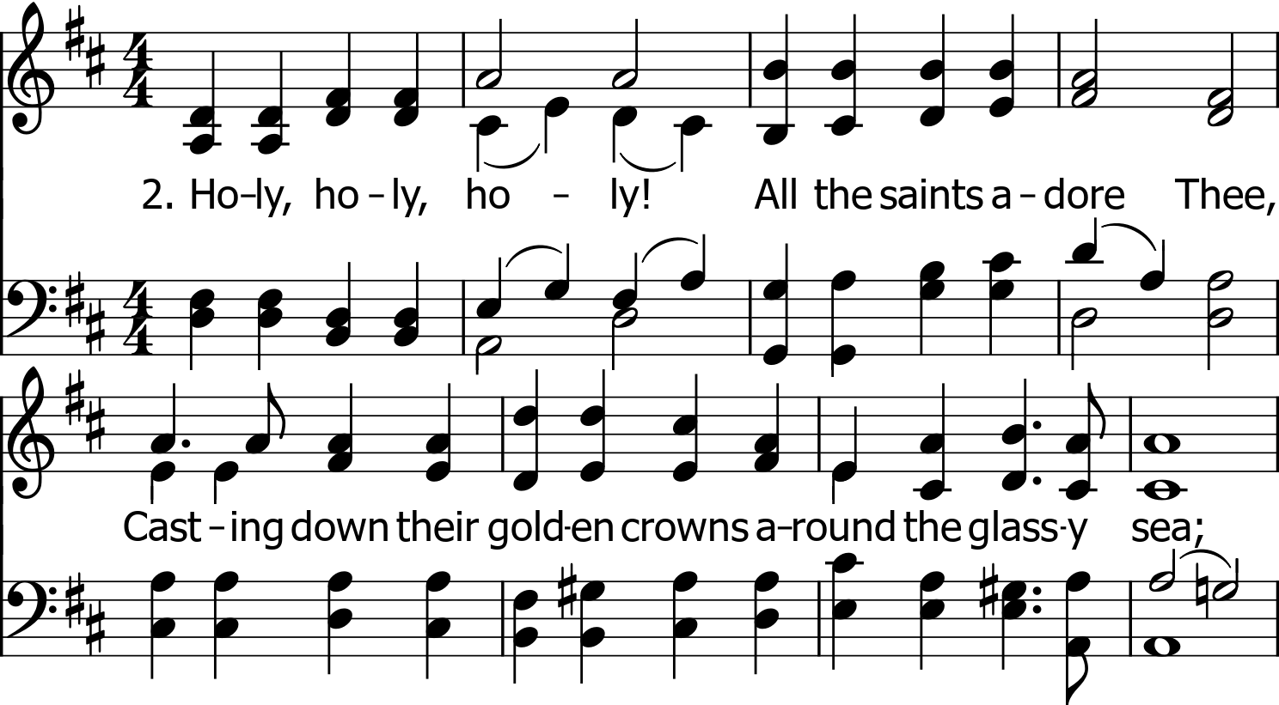
Public Domain

Slide 22
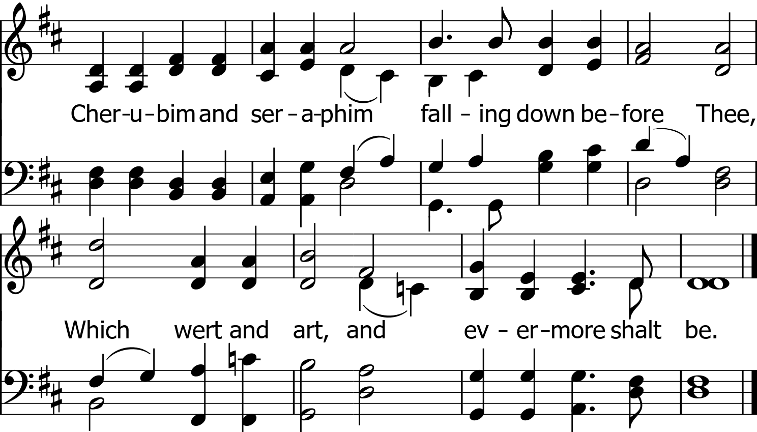
Public Domain

Slide 23
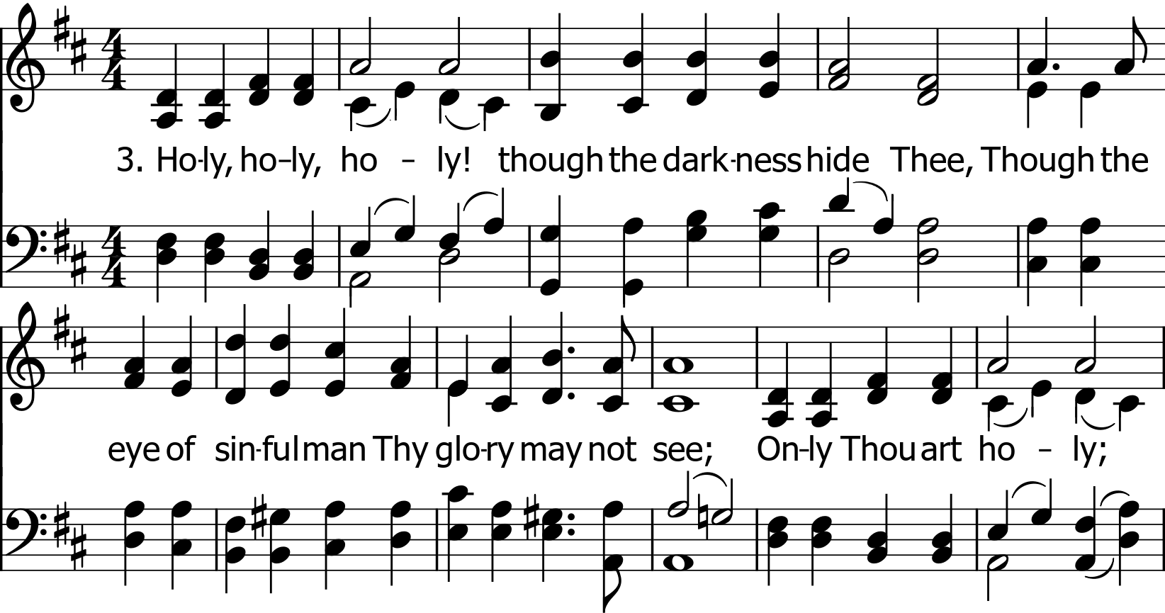
Public Domain

Slide 24
Public Domain

Slide 25
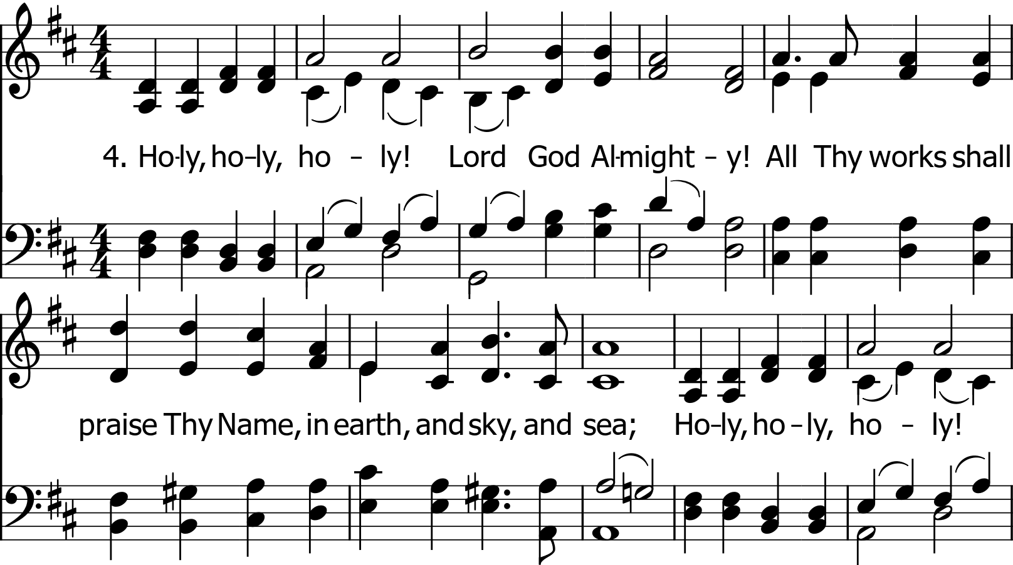
Public Domain

Slide 26
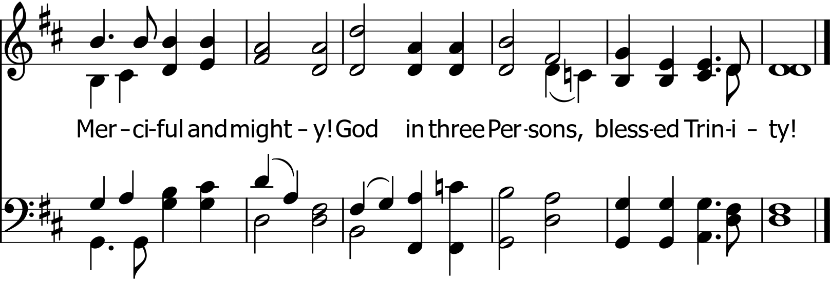
Public Domain

