Slide 1

Notes:
You are welcome to use or modify these PowerPoints as needed. Feel free to change the design or layout to suit your ministry, school, home, or company. More PowerPoint slides can be found at mobilehymns.org

Slide 2
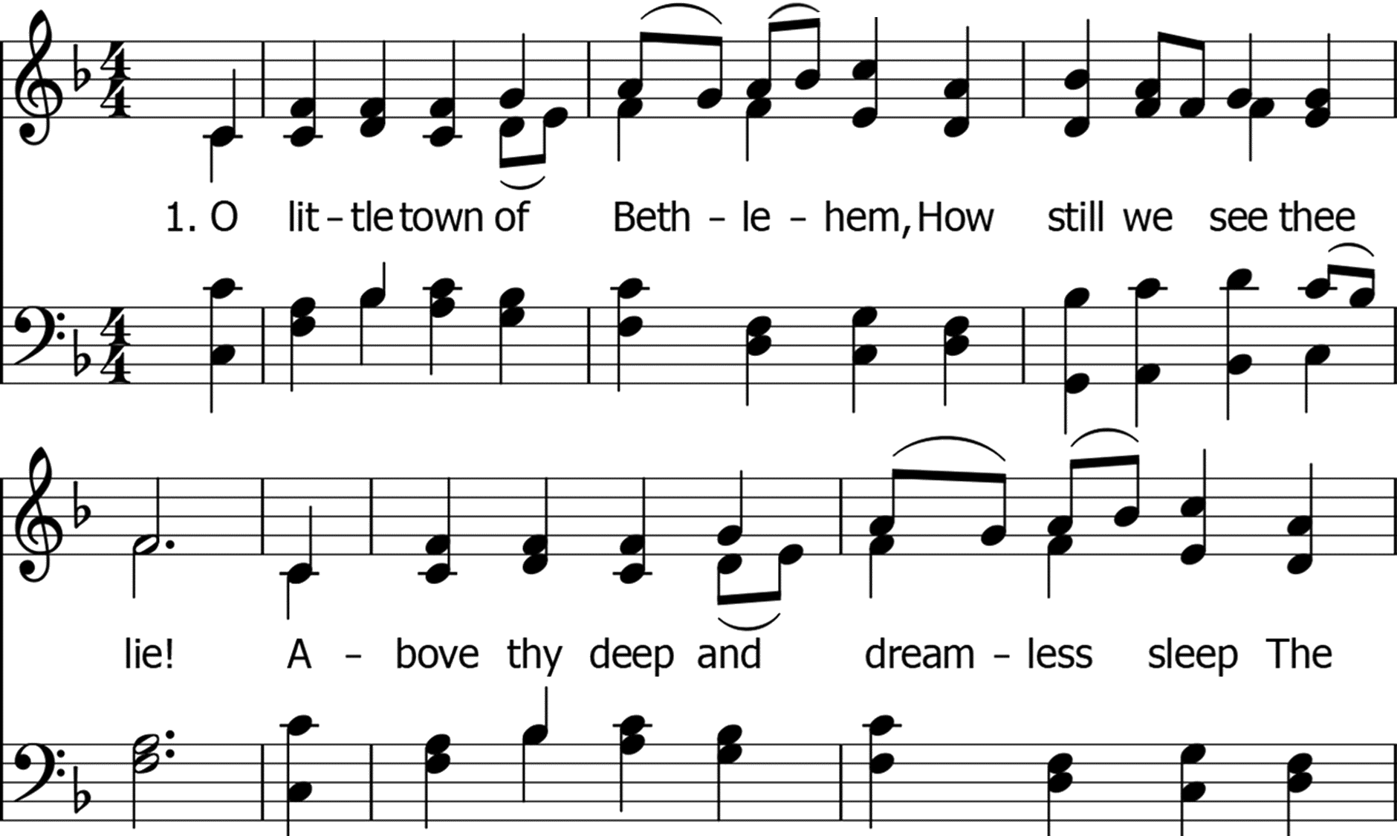

Slide 3
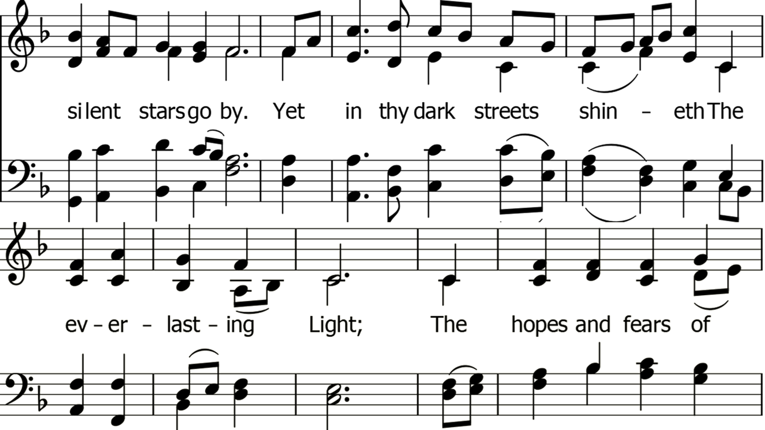

Slide 4
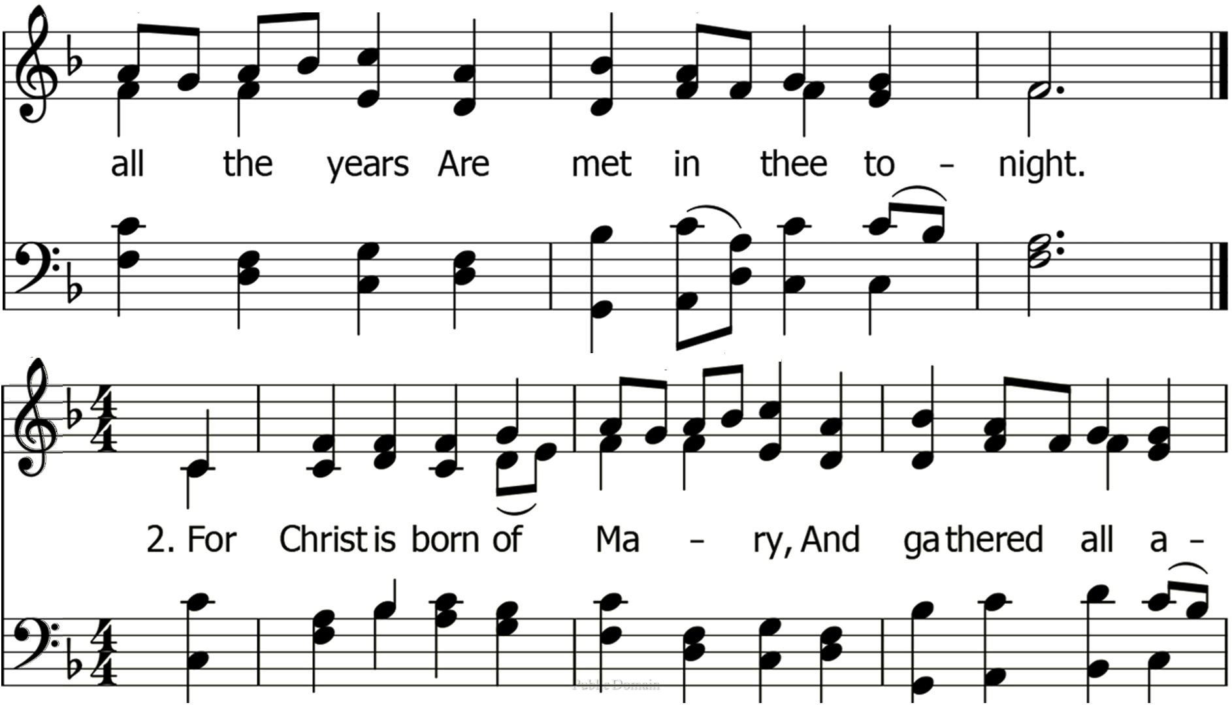

Slide 5
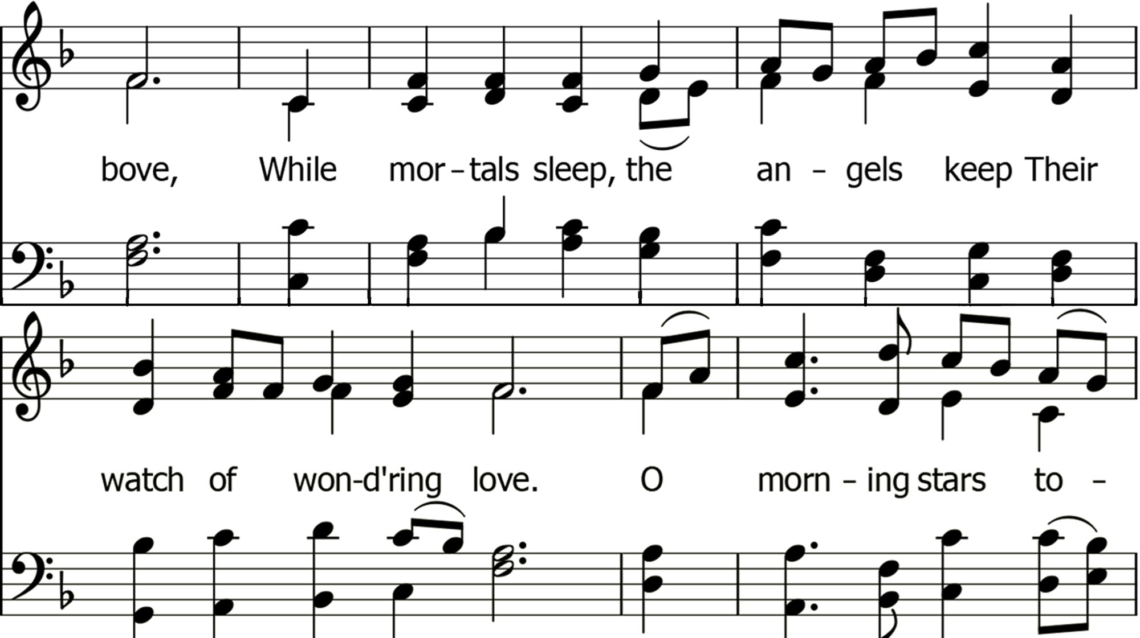

Slide 6
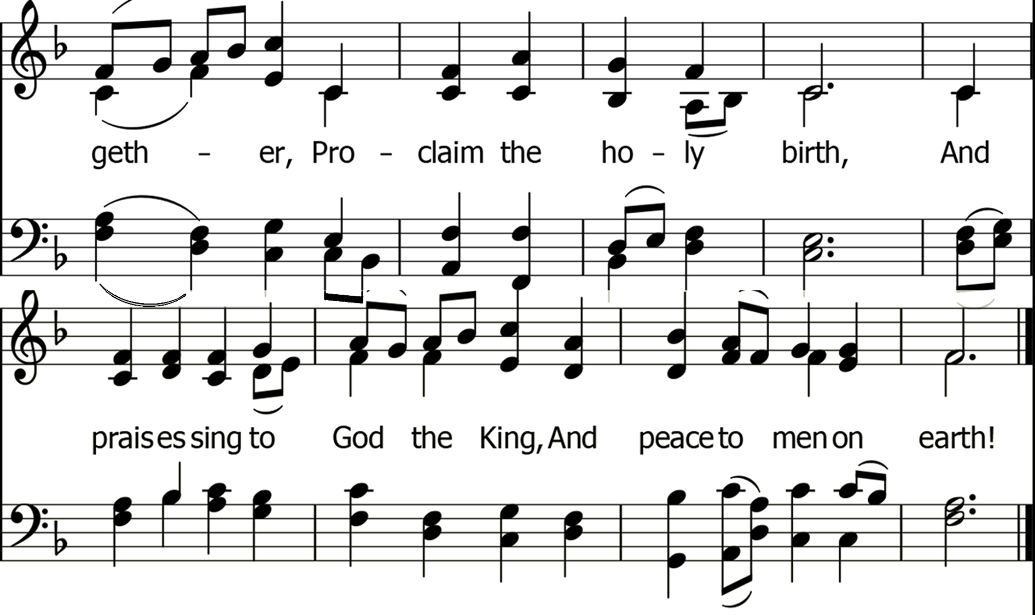

Slide 7
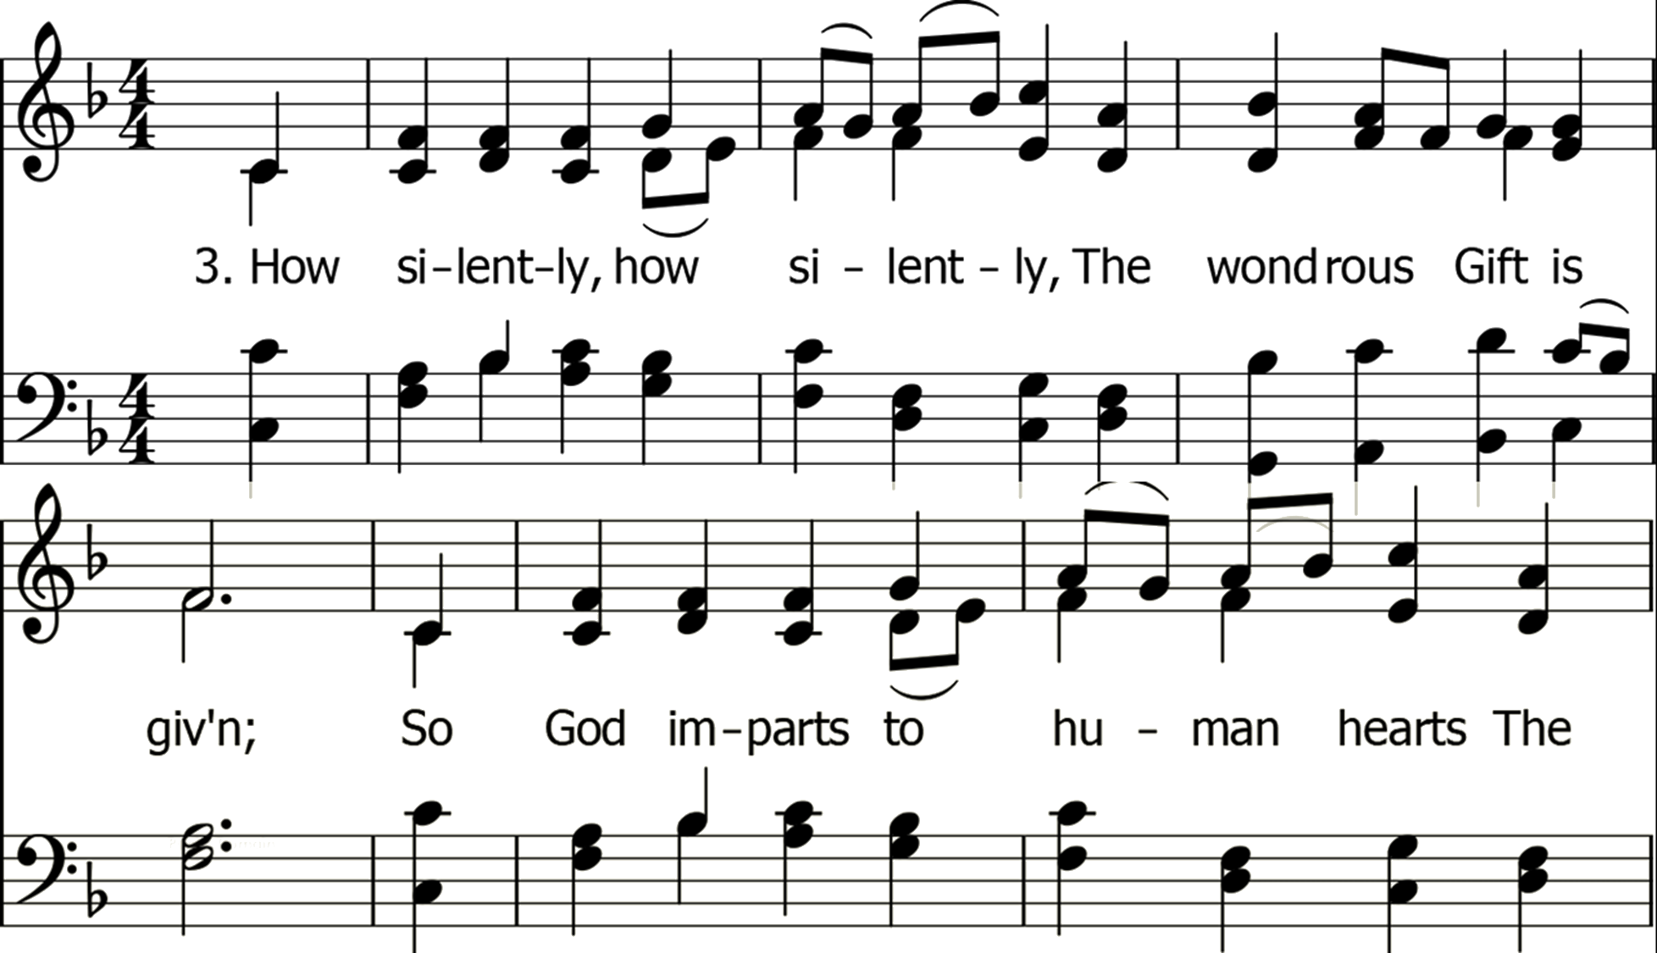

Slide 8
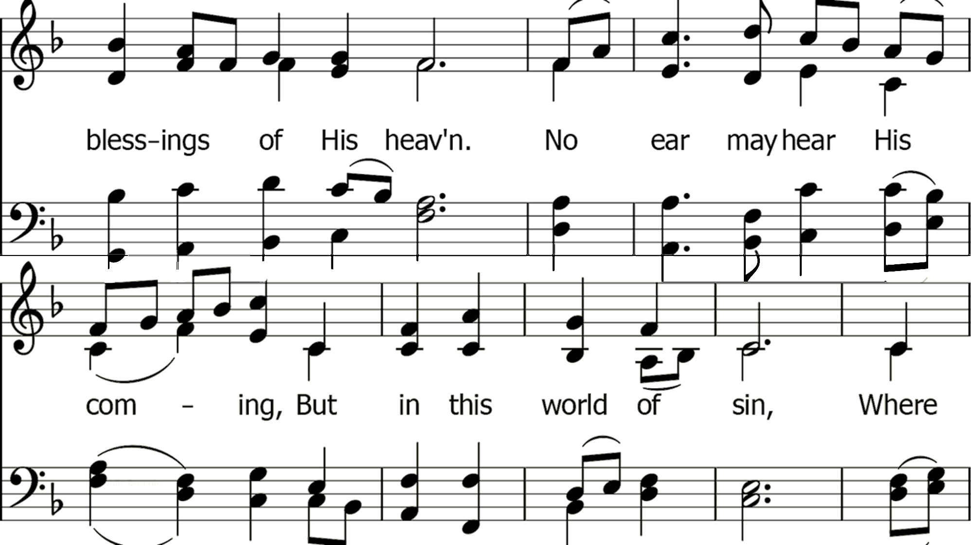

Slide 9


Slide 10
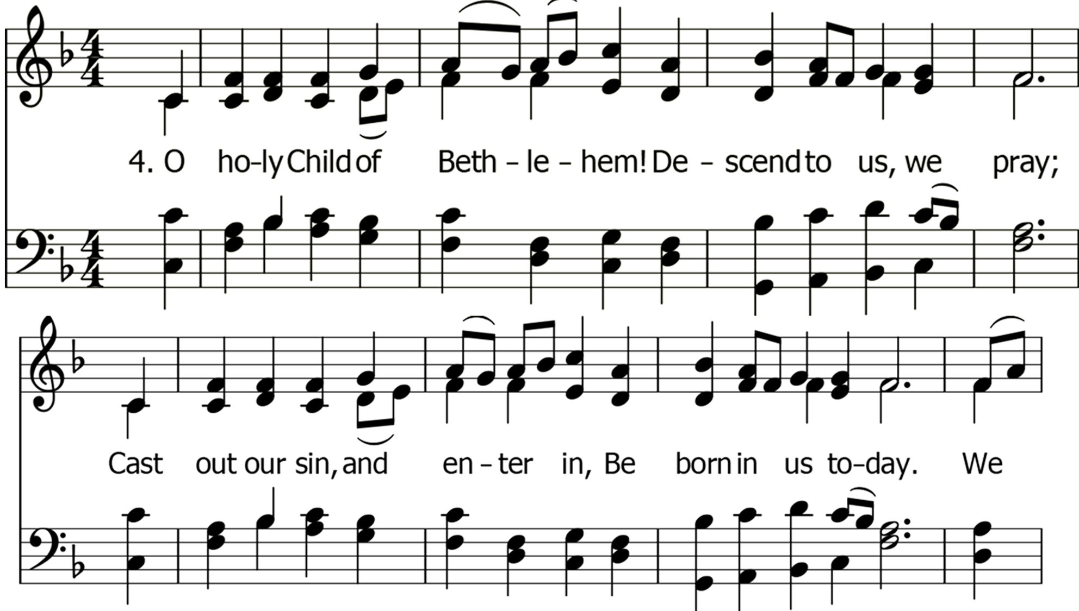

Slide 11
